Slide 1
COMP 2920 : Software Architecture & Design
UML Sequence Diagrams

Slide 2
UML sequence diagrams
sequence diagram: an "interaction diagram" that models a single scenario executing in the system
  perhaps 2nd most used UML diagram (behind class diagram)
relation of UML diagrams to other exercises:
  Class Responsibility Collaboration -> class diagram
  use cases -> sequence diagrams

Slide 3
What does it model
capture the interaction between objects in the context of a collaboration
show object instances that play the roles and needed in a collaboration
show the order of the interaction visually by using the vertical axis of the diagram to represent time what messages are sent and when
show elements as they interact over time, showing interactions or interaction instances
do not show the structural relationships between objects

Slide 4
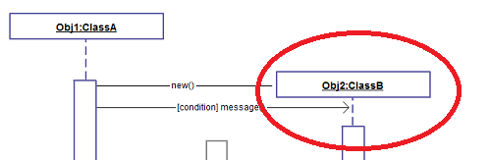
Key parts of a sequence diag.
participant: an object or entity that acts in the sequence diagram
  sequence diagram starts with an unattached "found message" arrow

Slide 5
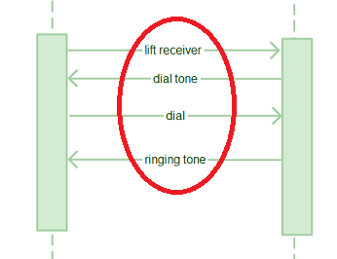
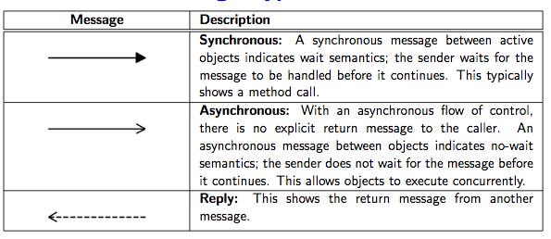
Key parts of a sequence diag.
message: communication between participant objects

Slide 6
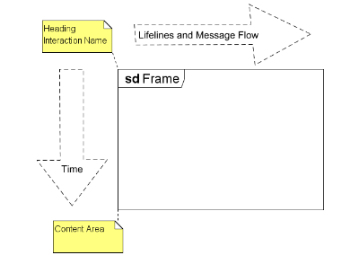
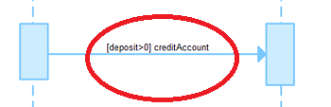
Key parts of a sequence diag.
the axes in a sequence diagram:
  horizontal: which object/participant is acting
  vertical: time (down -> forward in time)
Guards : the conditions to be met

Slide 7
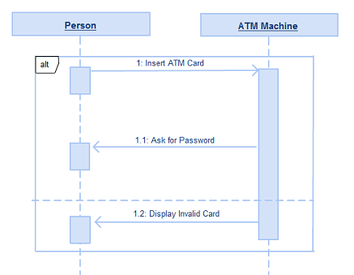
More parts
Alternatives : to indicate a mutually exclusive choice that exists between more that one message sequence.

Slide 8
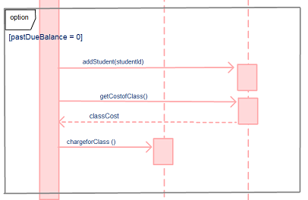
More parts
Options : to model a sequence that will occur provided it is given a certain condition. If not, the sequence does not occur.

Slide 9
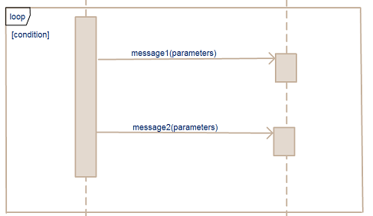
More parts
Loops : to model a repetitive sequence

Slide 10
Steps
5 steps to follow:
Define who will initiate the transaction
Draw the first message to the subsystem
Draw message to other sub system
Draw return message to actor
Send/respond to anonymous actors

Slide 11
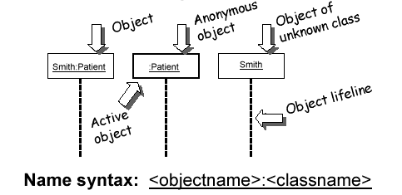
Representing objects
Squares with object type, optionally preceded by object name and colon
  write object's name if it clarifies the diagram
  object's "life line" represented by dashed vert. line

Slide 12
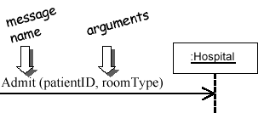
Messages between objects
message (method call) indicated by horizontal arrow to other object
  write message name and arguments above arrow

Slide 13
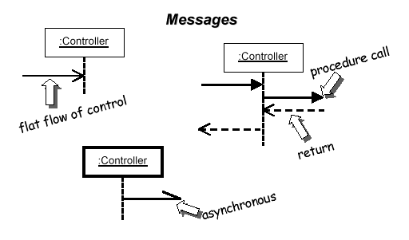
Messages, continued
message (method call) indicated by horizontal arrow to other object
  dashed arrow back indicates return
  different arrowheads for normal / concurrent (asynchronous) methods

Slide 14
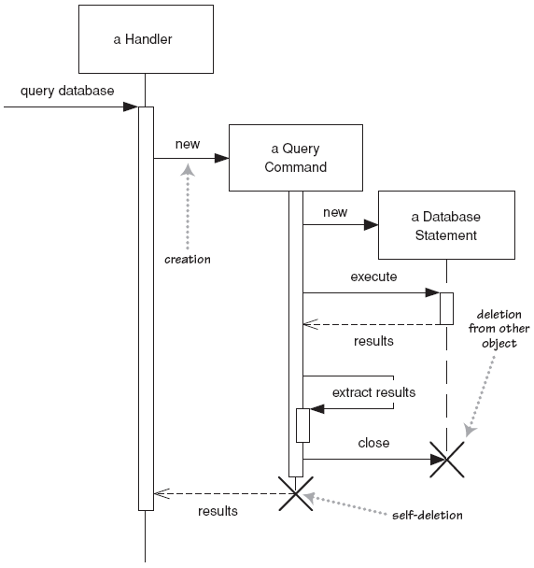
Lifetime of objects
creation: arrow with 'new' written above it
  notice that an object created after the start of the scenario appears lower than the others
deletion: an X at bottom of object's lifeline
  Java doesn't explicitly delete objects; they fall out of scope and are garbage-collected

Slide 15
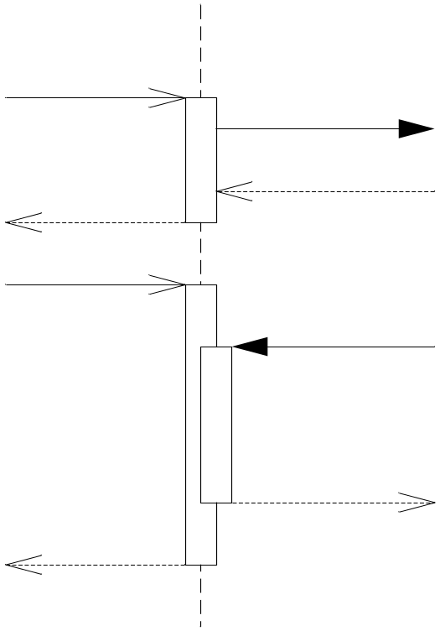
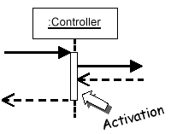
Indicating method calls
activation: thick box over object's life line; drawn when object's method is on the stack
  either that object is running its code, or it is on the stack waiting for another object's method to finish
  nest to indicate recursion
Activation
Nesting

Slide 16
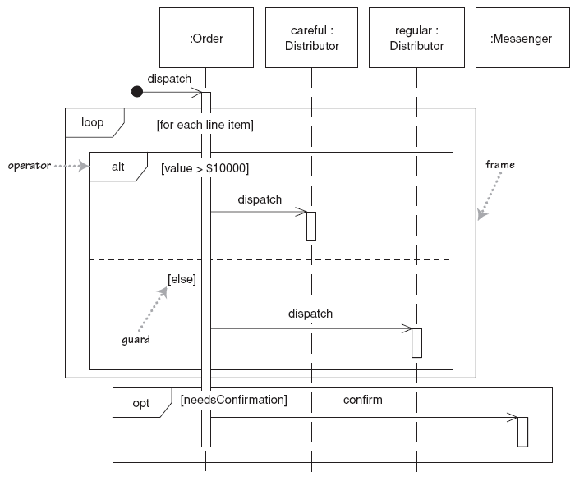
Indicating selection and loops
frame: box around part of a sequence diagram to indicate selection or loop
  if -> (opt) [condition]
  if/else -> (alt) [condition], separated by hor. dashed line
  loop -> (loop) [condition or items to loop over]

Slide 17
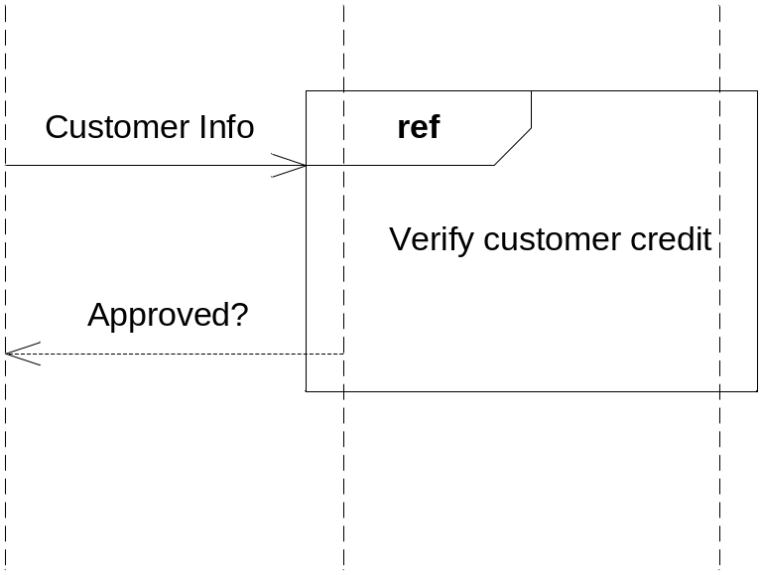
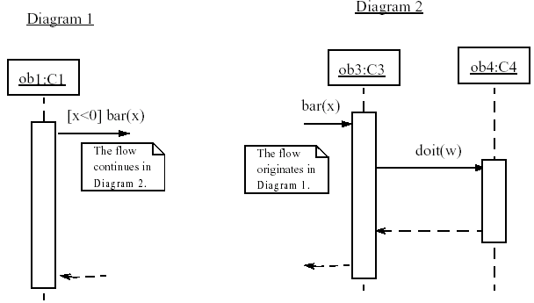
linking sequence diagrams
if one sequence diagram is too large or refers to another diagram, indicate it with either:
  an unfinished arrow and comment
  a "ref" frame that names the other diagram
  when would this occur in our system?

Slide 18
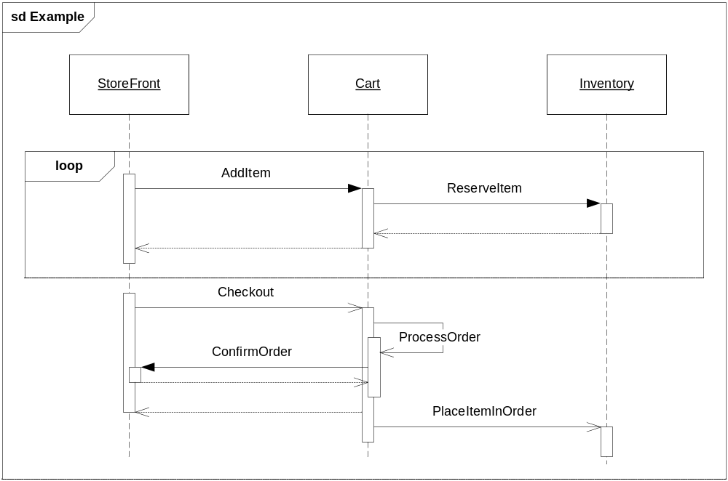
Example sequence diagram

Slide 19
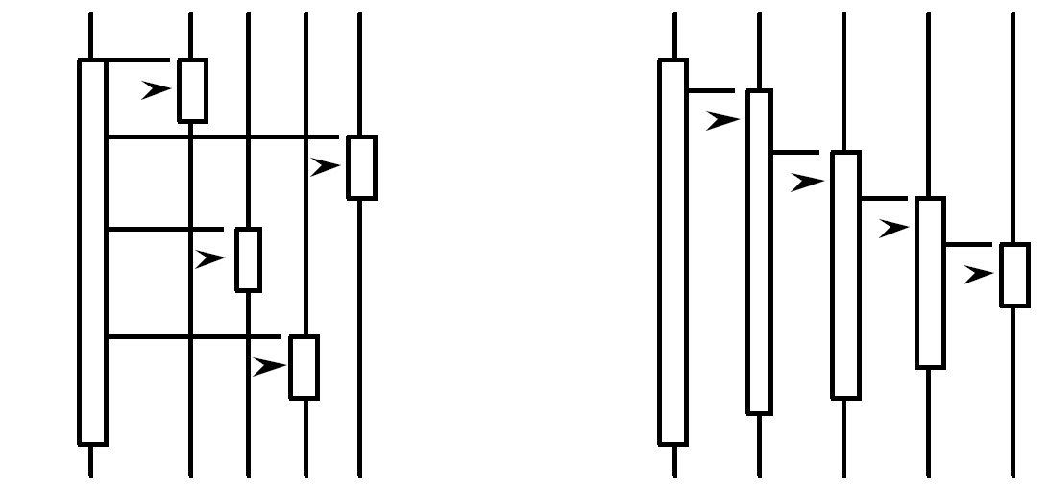
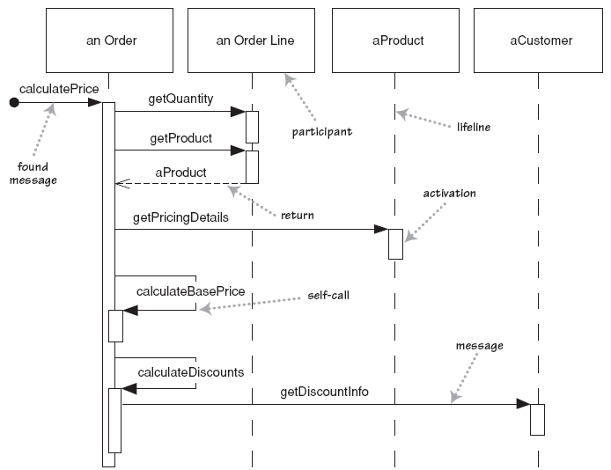
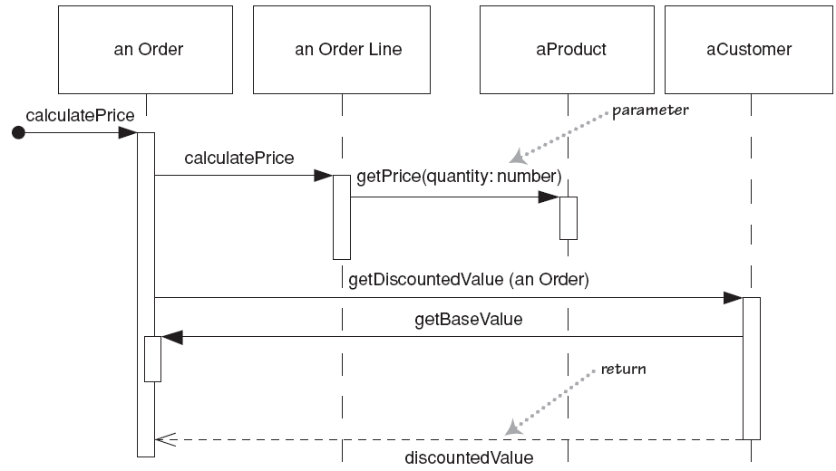
Forms of system control
What can you say about the control flow of each of the following systems?
  Is it centralized?
  Is it distributed?

Slide 20
Why not just code it?
Sequence diagrams can be somewhat close to the code level. So why not just code up that algorithm rather than drawing it as a sequence diagram?
  a good sequence diagram is still a bit above the level of the real code (not all code is drawn on diagram)
  sequence diagrams are language-agnostic (can be implemented in many different languages
  non-coders can do sequence diagrams
  easier to do sequence diagrams as a team
  can see many objects/classes at a time on same page (visual bandwidth)

Slide 21
Sequence diagram exercise 1
Let's do a sequence diagram for the following casual use case, Start New Poker Round :
  The scenario begins when the player chooses to start a new round in the UI. The UI asks whether any new players want to join the round; if so, the new players are added using the UI.
  All players' hands are emptied into the deck, which is then shuffled. The player left of the dealer supplies an ante bet of the proper amount. Next each player is dealt a hand of two cards from the deck in a round-robin fashion; one card to each player, then the second card.
  If the player left of the dealer doesn't have enough money to ante, he/she is removed from the game, and the next player supplies the ante. If that player also cannot afford the ante, this cycle continues until such a player is found or all players are removed.

Slide 22
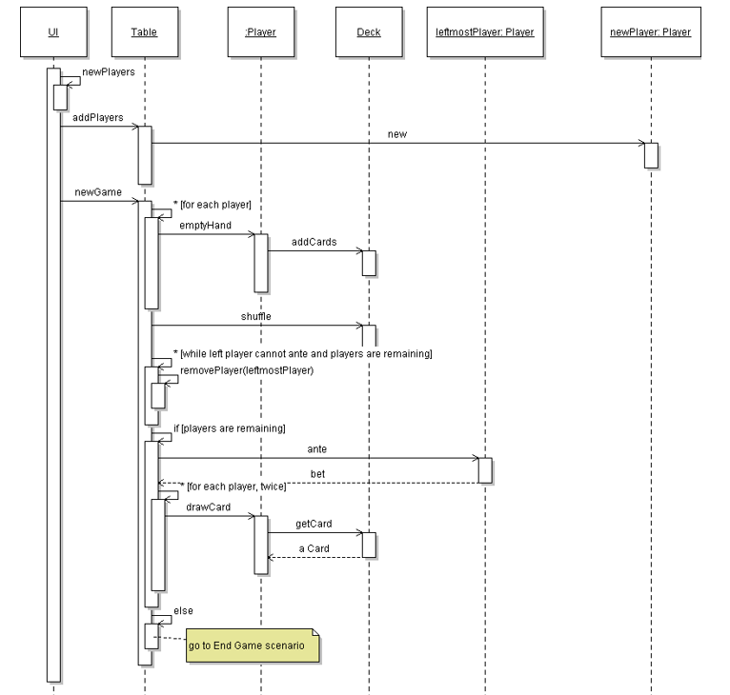
Solution

Slide 23
Sequence diagram exercise 2
Let's do a sequence diagram for the following casual use case, Add Calendar Appointment :
  The scenario begins when the user chooses to add a new appointment in the UI. The UI notices which part of the calendar is active and pops up an Add Appointment window for that date and time.
  The user enters the necessary information about the appointment's name, location, start and end times. The UI will prevent the user from entering an appointment that has invalid information, such as an empty name or negative duration. The calendar records the new appointment in the user's list of appointments. Any reminder selected by the user is added to the list of reminders.
  If the user already has an appointment at that time, the user is shown a warning message and asked to choose an available time or replace the previous appointment. If the user enters an appointment with the same name and duration as an existing group meeting, the calendar asks the user whether he/she intended to join that group meeting instead. If so, the user is added to that group meeting's list of participants.

Slide 24
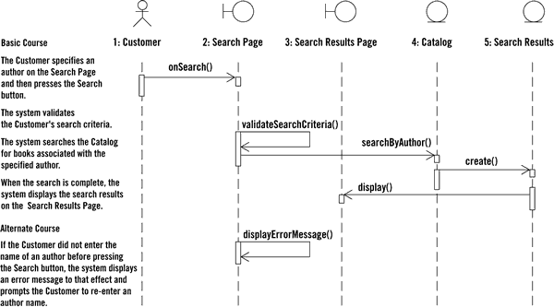
Example

